Slide 1




FINAL PROJECT PRESENTATION
QuickServe
Localized Service Discovery & Booking Platform

Slide 2


The Problem
For Customers: Finding reliable local help (plumbers, electricians) is chaotic. It relies on word-of-mouth, lacks transparency in pricing, and availability is often unknown.
For Providers: Skilled independent workers struggle to market themselves, manage their schedules efficiently, and build a verified reputation.

Slide 3


Our Solution: QuickServe
A Centralized Marketplace
QuickServe bridges the gap between demand and supply with a robust full-stack application.
Discover: Location-based search for verified professionals.
Verify: Transparent profiles with ratings, skills, and past work.
Book: Real-time slot booking with instant confirmation.

Slide 4






Modern Technology Stack
Frontend
Backend
Database
React.js
Spring Boot 3
PostgreSQL (NeonDB)
Single Page Application (SPA) for a responsive, app-like user experience. Uses Axios for API communication.
RESTful API architecture with Spring Security (JWT) for stateless authentication and robust business logic.
Relational database ensuring data integrity for complex booking transactions and user profiles.

Slide 5





Three-Tier Architecture
Presentation
Application
Data Persistence
React Client (Port 3000)
Spring Boot API (Port 8080)
NeonDB PostgreSQL
Handles UI, State, & Routing. Sends JSON requests.
Exposes REST Endpoints. Handles Logic, Security (JWT), & DTOs.
Cloud-hosted storage. Uses Foreign Keys for data integrity.

Slide 6
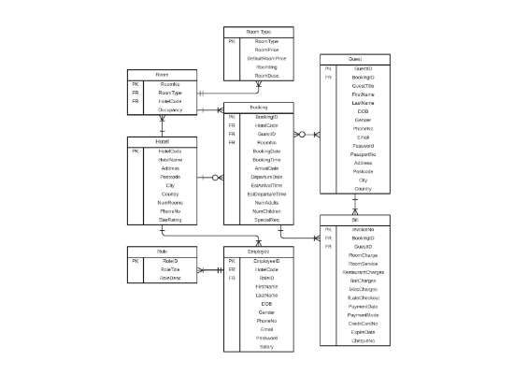
Database Schema Design
Complete Entity List
Users: Central auth table. Contains Email, Password, Role, Address, Pincode.
ServiceProviders: Linked 1-to-1 with Users. Contains Business Name, Skills, Rating, Experience.
ProviderServices: The "Menu" of services. Includes Price, Duration.
ProviderWorkingHours: Stores 7-day schedule (Open/Close times).
Bookings: Transaction table. Tracks Status, Job Description, and links Customer/Provider.
Reviews: Stores Ratings & Comments linked to Bookings.

Slide 7






Database Schema Structure
Users
ServiceProviders
Bookings
PK user_id (BigInt)
PK provider_id (BigInt)
PK booking_id (BigInt)
full_name, email, password_hash
FK user_id (Unique)
FK customer_id, provider_id
address, pincode, phone_number
business_name, category
FK service_id, service_title
role (Enum), email_verified (Bool)
rating (Numeric), completed_jobs
status, agreed_price (Numeric)
otp_expires, reset_password_token
latitude, longitude (Double)
scheduled_date, time
skills, experience, profile_url
description, address, contact_phone
ProviderServices
WorkingHours
Reviews
PK service_id (BigInt)
PK id (BigInt)
PK review_id (BigInt)
FK provider_id (BigInt)
FK provider_id (BigInt)
FK booking_id (Unique)
name, price (Numeric)
day_of_week, is_closed
rating (Int), comment
duration (Int), is_active (Bool)
open_time, close_time
created_at (Timestamp)
rating, review_count

Slide 8
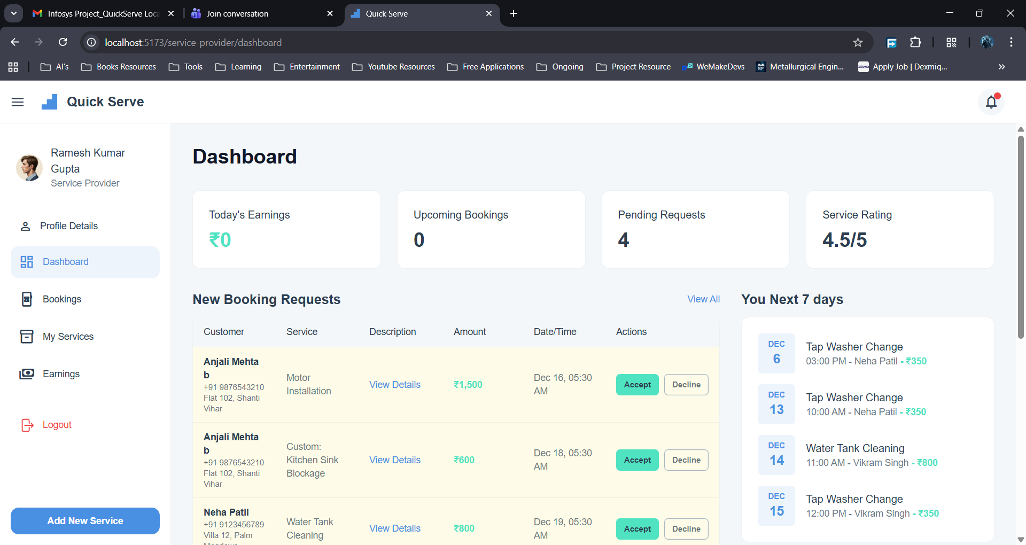
Provider Dashboard
"Mission Control" for Workers
We built a highly efficient dashboard that aggregates data from multiple tables into a single API response for performance.
Real-time Stats: Today's earnings, Pending request counts.
Actionable Items: "Accept/Decline" cards for new booking requests.
Analytics: Interactive charts showing weekly/monthly revenue trends using Aggregated SQL queries.

Slide 9






Security & Authentication
BCrypt Hashing
JWT Tokens
CORS Config
Passwords are never stored in plain text. We use BCrypt encryption to hash passwords before saving to the database.
Stateless authentication. Upon login, the server issues a signed JSON Web Token. The client sends this token with every request.
Custom security configuration to allow our React Frontend (localhost:3000) to safely communicate with the Backend API.

Slide 10




Customer Workflow
Search
Select
Book
Track
Filter by Category or Location
View Profiles & Verified Reviews
Choose Time Slot & Confirm
Status Updates (Pending -> Confirmed)

Slide 11
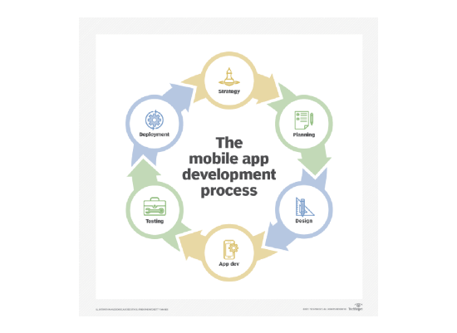
Future Roadmap
Mobile Application: Since we built a REST API, we can easily attach a React Native mobile app to the same backend.
Payment Gateway: Integration with Stripe or Razorpay for secure online payments.
Real-time Location: Live tracking of providers using Geolocation API.
AI Recommendations: Suggesting services based on user history and seasonal needs.

Slide 12

Conclusion & Learning Outcomes
Learning Outcomes
Full-Stack Mastery: Integrating React with a Spring Boot REST API.
Conclusion
QuickServe bridges the gap in the local service economy by digitizing the booking process. We have successfully created a platform that offers transparency, speed, and reliability to both customers and service providers.
Architectural Depth: Designing scalable schemas and secure authentication flows.
Professional Workflow: Version control, API testing, and cloud database management.
Real-World Readiness: Building a production-grade application structure.

Slide 13

Thank You
QuickServe demonstrates the power of modern full-stack development to solve real-world problems.

